Slide 1
The Meantime Wheel
Roxana Ciocian & Cocis George
30431

Slide 2
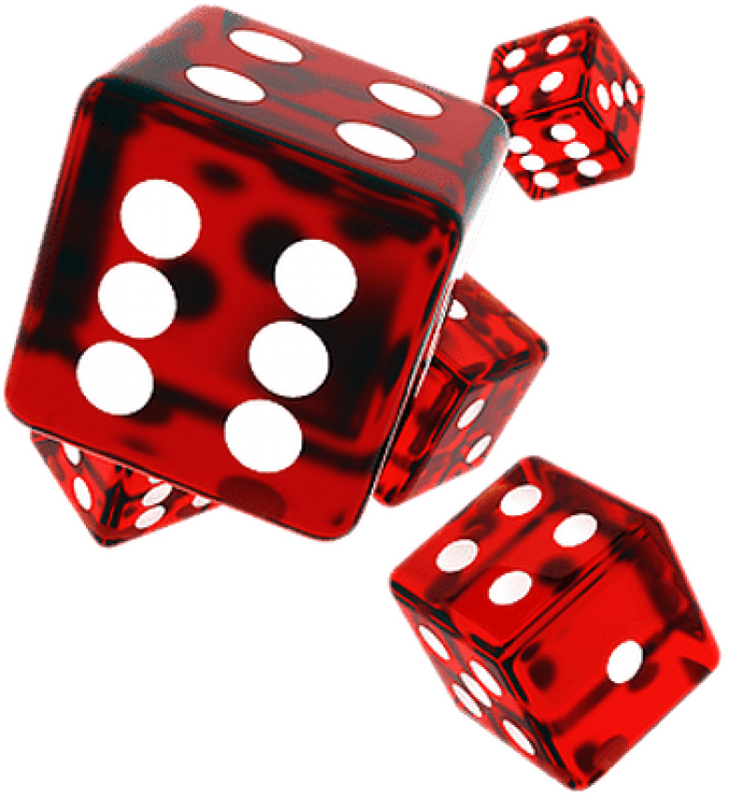

General Presentation
C# application, for users to ‘waste’ time constructively
3 types of actors: visitor, user, moderator
Based on a roll from [1-8], the spinning wheel unlocks one of the 8 possible minigames
The minigames offer different experiences, varying from trivia games to 2D platformers
In game tokens

Slide 3

Theoretical Fundamentals
MySQL WorkBench for designing the database
The database contains info about the actors
User: id, firstname, lastname, country, email, phone, username, password
Moderator: email, username, password
For user, separate table with tokens

Slide 4
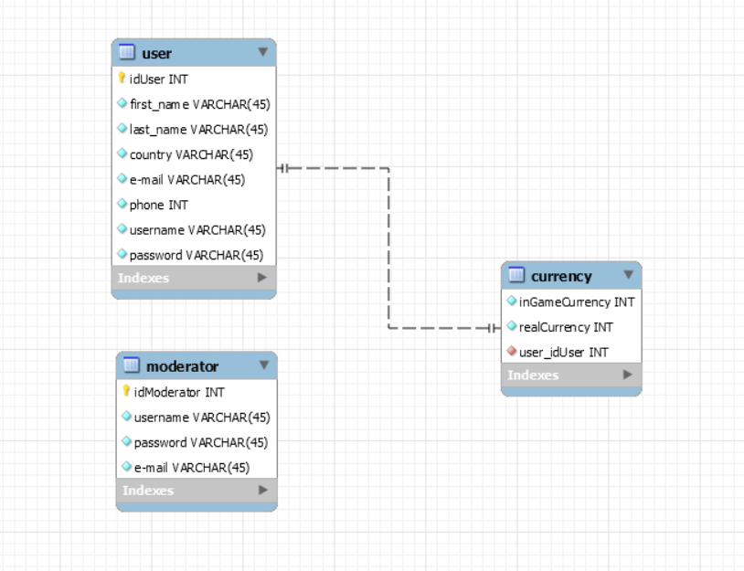
Theoretical Fundamentals – Database Diagram

Slide 5

IT Technology
IDE: Microsoft Visual Studio 2019
C# language
windows form application, supported by Microsoft’s .NET framework

Slide 6
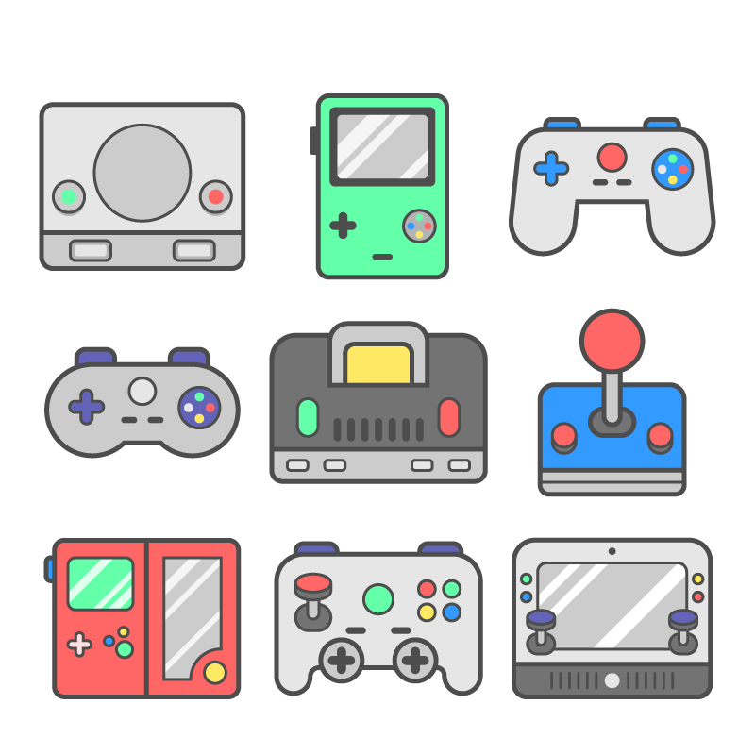

Functionalities
In the absence of an account, it can be created
Moderators log into the moderator window
Users log into the user window: topup/withdraw, wheel
Wheel contains 8 different minigames
Based on the roll, a game becomes available

Slide 7

Functionalities – Trivia
Trivia launches upon clicking Act1
6 trivia categories: songs, movies, pop culture, flags, video games, Harry Potter
With respect to the category, a set of 10 questions will be picked
1 point for each correct answer
15 seconds for each question

Slide 8




Functionalities - Pac-Man
Pac-Man launches upon clicking Act3
Maze chase video game
Pac-Man controlled by keys
Purpose is to collect all the pieces of food
If Pac-Man collides with a ghost, the game ends

Slide 9
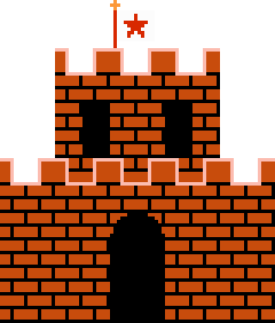

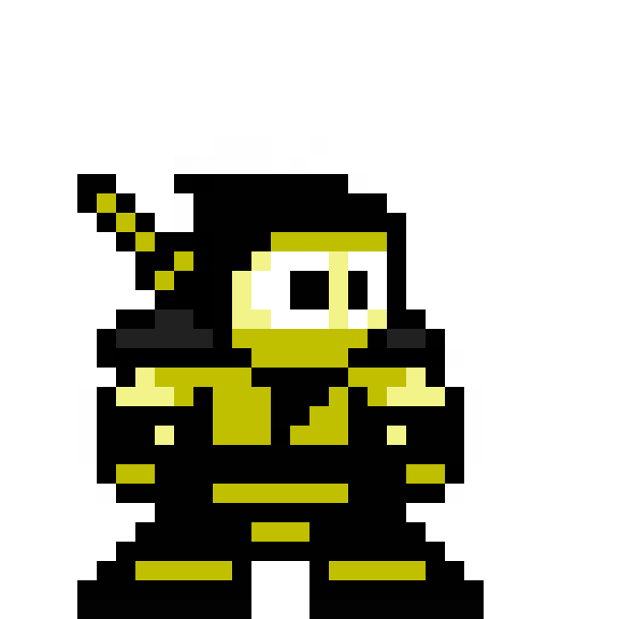


Functionalities - Platformer
Platformer launches upon clicking Act2
2d character controlled by keys
The purpose is to collect as many coins as possible & reach the castle
If the character collides with an enemy or a trap, the game ends
If the character falls off the map, the game ends

Slide 10


Functionalities – Match the Cards
Match the Cards launches upon clicking Act4
16 total cards, 8 sets x 2 cards
Cards are initially face down
The player tries to match two cards each turn
The purpose of the game is to match all the 8 pairs of cards
The player must match all the cards in less than a minute to win

Slide 11

Functionalities - Jukebox
Jukebox is launched upon pressing Act5
The visual interface consists of buttons
Upon pressing, each button will make a different sound
This environment has no final goal whatsoever
Does not reward coins
Simply for fun

Slide 12

Functionalities – Learning Environment
Learning Environment is launched upon clicking Act6
There are three different parts: Correct answer, Continue the snippet, Write the answer
Each part contains three questions
The game ends when all the questions have been completed
If the player gives a wrong answer, the game restarts

Slide 13
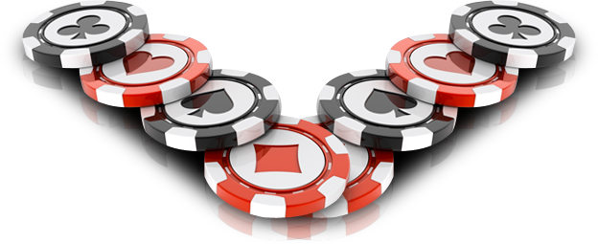
Functionalities - Gambling
Gambling launches upon clicking Act7
the player has a vault – database
he can bet in game/real currency on different betting games
If the player loses, the amount bet it lost
If the player wins, the amount bet is doubled

Slide 14

Functionalities - Puzzle
Puzzle launches upon clicking Act8
The player needs to reconstruct a picture
The player must rearrange 9 parts in order to reconstruct the initial picture
If the picture is not complete within 1 minute, the game ends

Slide 15

Actors and related access rights
3 possible actors: Visitor, User, Moderator
Visitors create a new account with the required info -> stored into database
Moderators can update the information within the database
Users can deposit/withdraw cash, play games and earn tokens -> stored into database

Slide 16
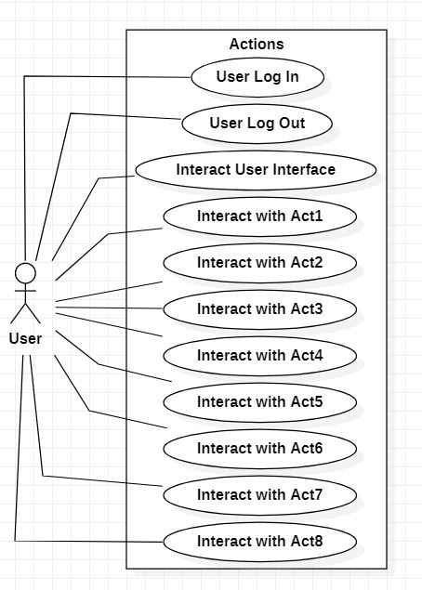
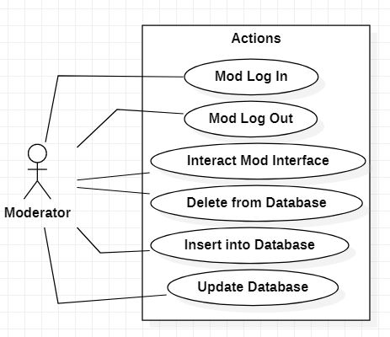
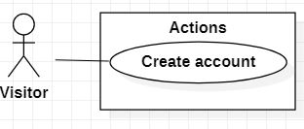
Use case diagrams

Slide 17
System Architecture
Each class(form) represents a different part of the GUI
Each object within a class has its own purpose
All the objects within a class => Application window
All the application windows => Application User Interface
All the classes are within the same namespace
Classes with similar contents are grouped in folders i.e: acts 1->8 under a folder, log in forms under a folder etc

Slide 18
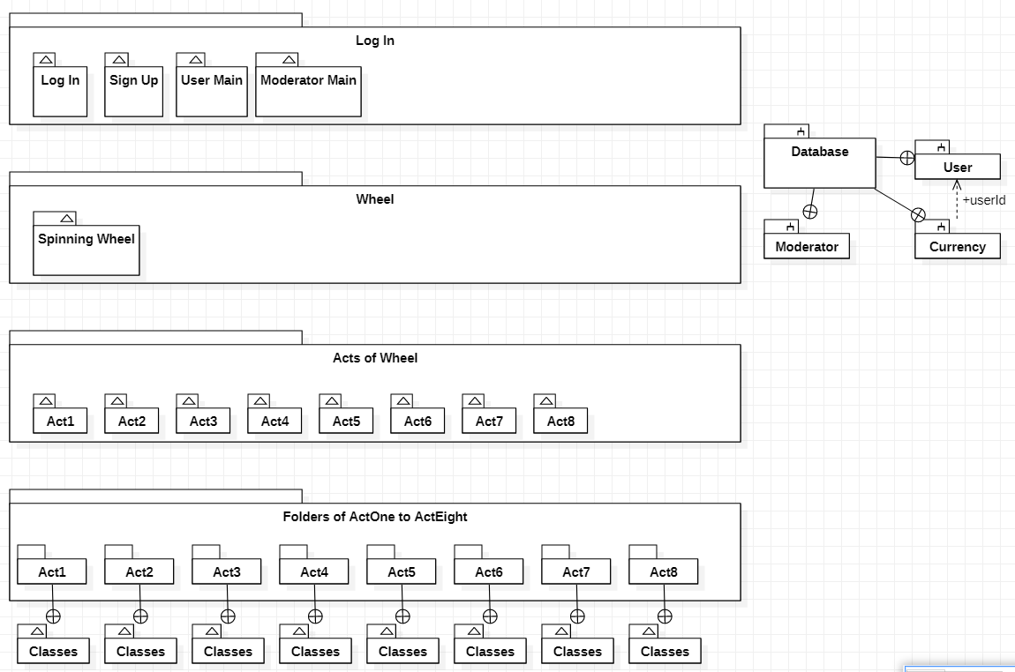
System Architecture - Diagram

Slide 19
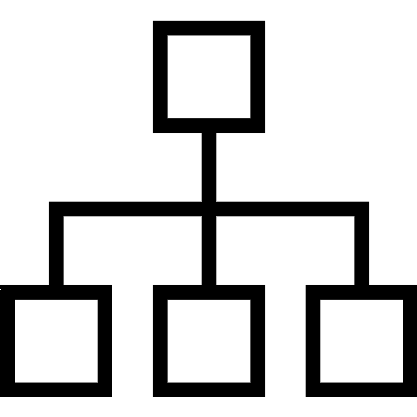
Design – UML Diagrams
Class Diagram
Object Diagram
Sequence Diagrams
Activity Diagram
State-Transition Diagram
Communication Diagrams
Component Diagram
Deployment Diagram

Slide 20
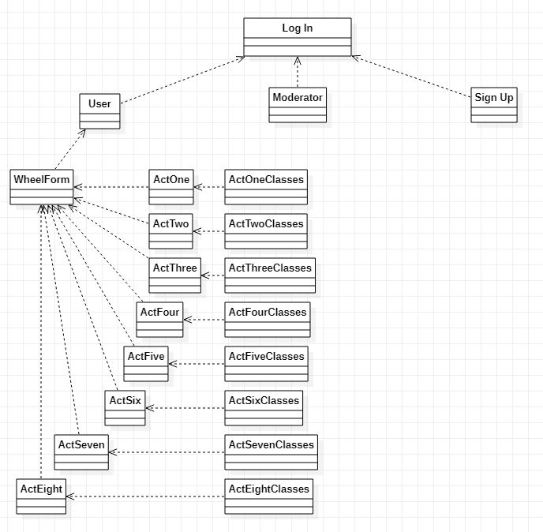
Design – Class Diagram

Slide 21
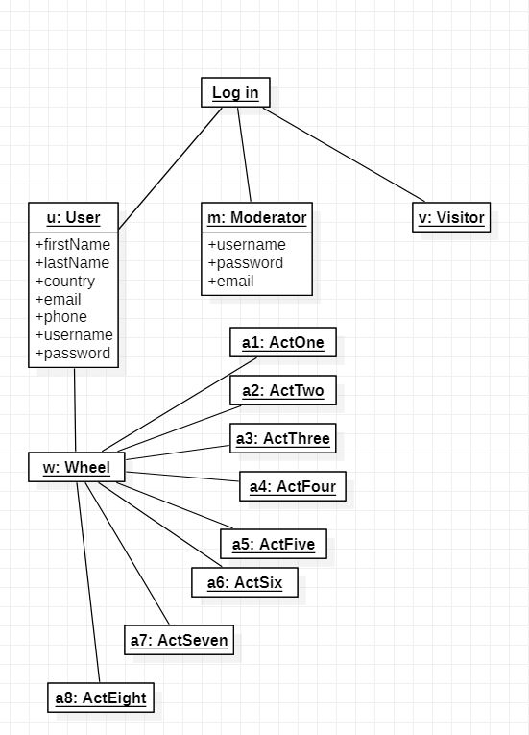
Design – Object Diagram

Slide 22
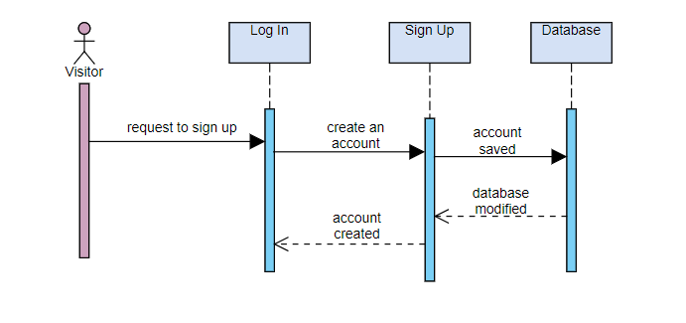
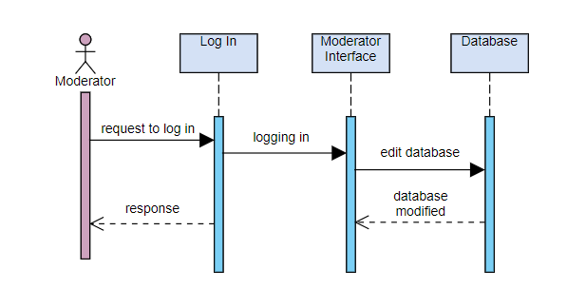
Design – Sequence Diagrams

Slide 23
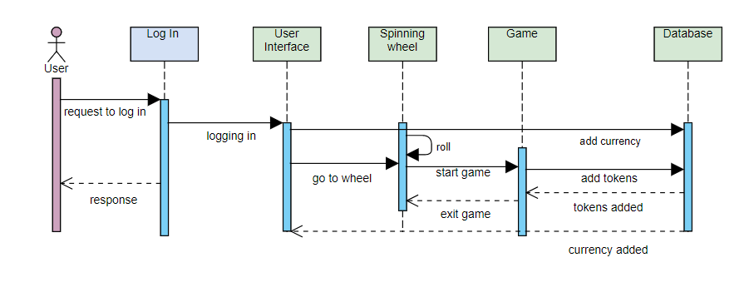
Design – Sequence Diagrams cont’d

Slide 24
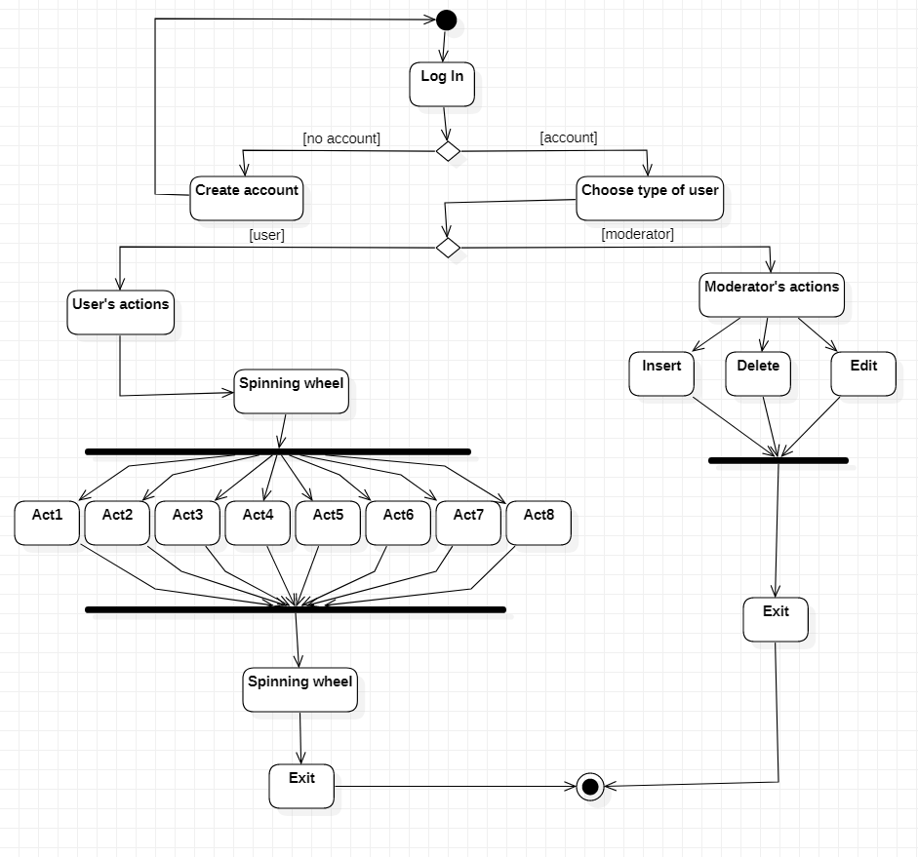
Design – Activity Diagram

Slide 25
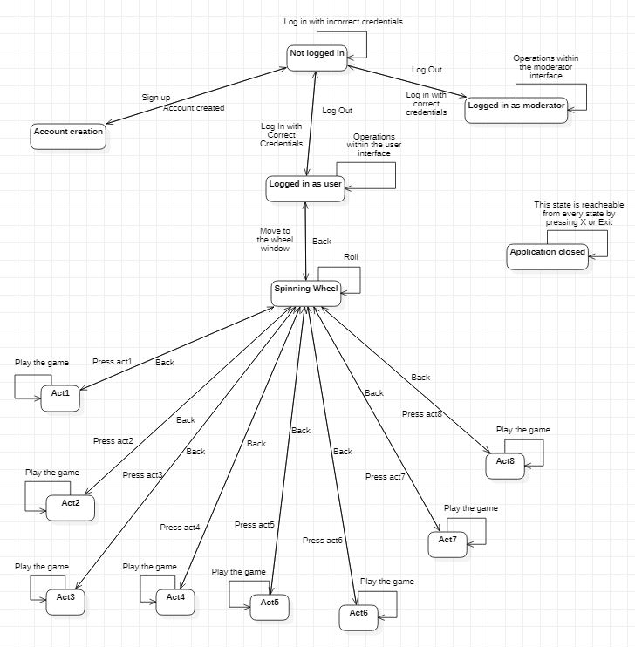
Design – State-Transition Diagram

Slide 26
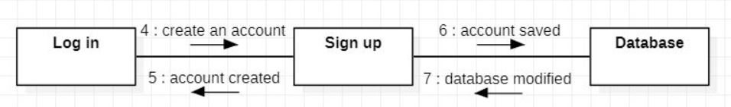
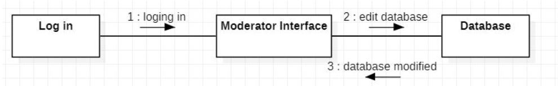
Design – Communication Diagrams
Visitor:
Moderator:

Slide 27
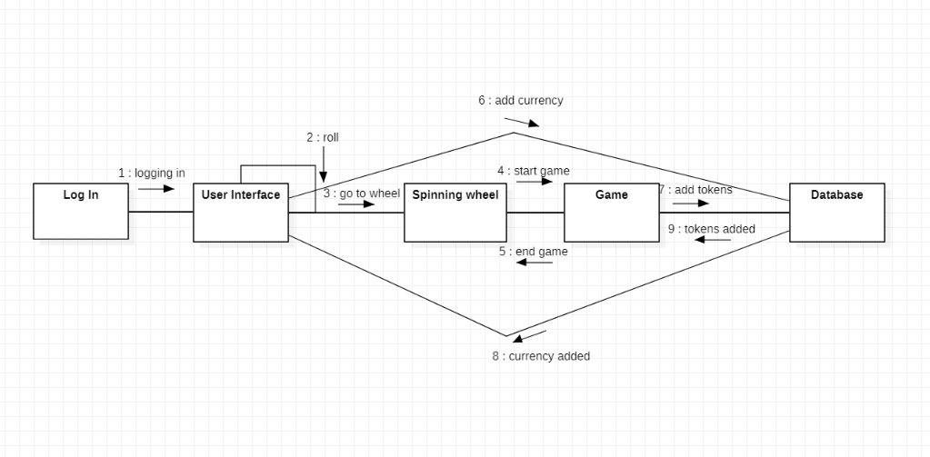
Design – Communication Diagrams cont’d
User:

Slide 28
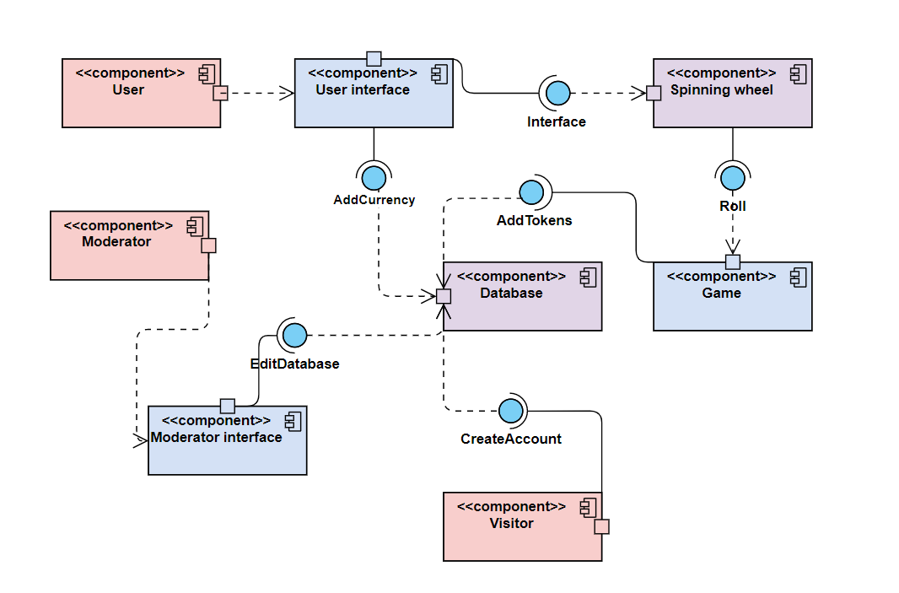
Design – Components Diagrams

Slide 29
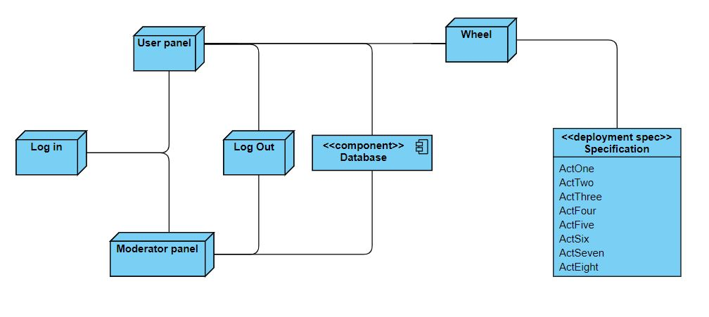
Design – Deployment Diagrams

Slide 30
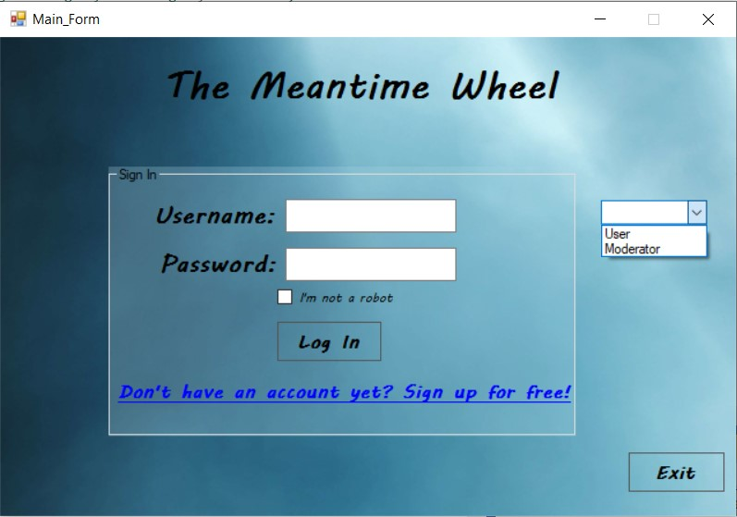
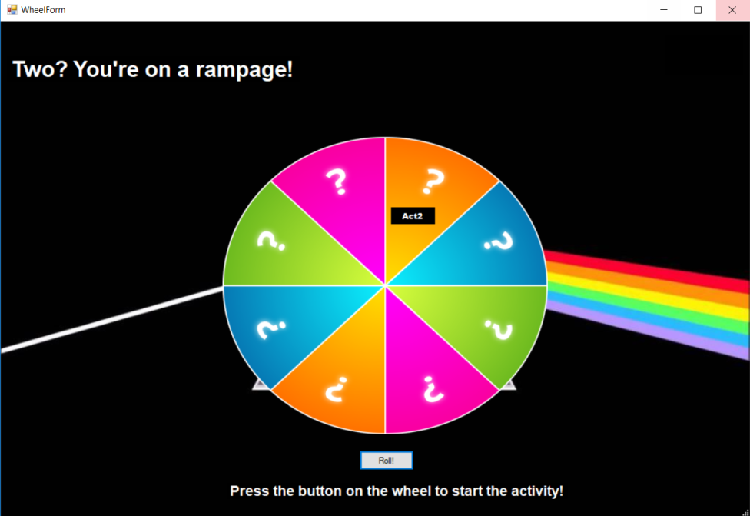
Screenshots

Slide 31
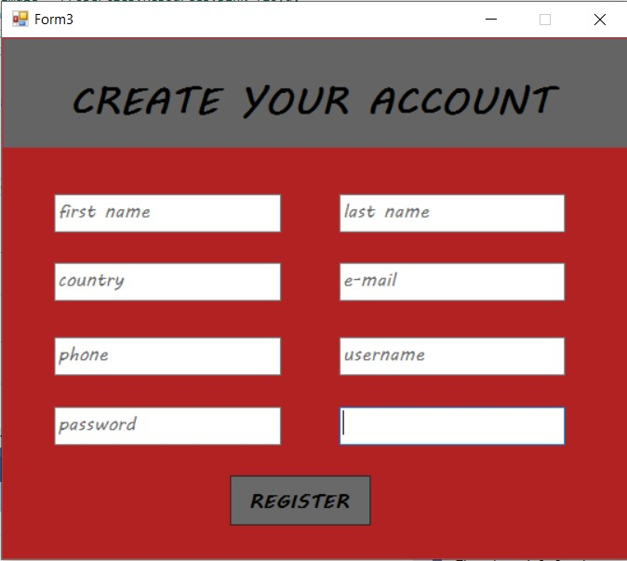
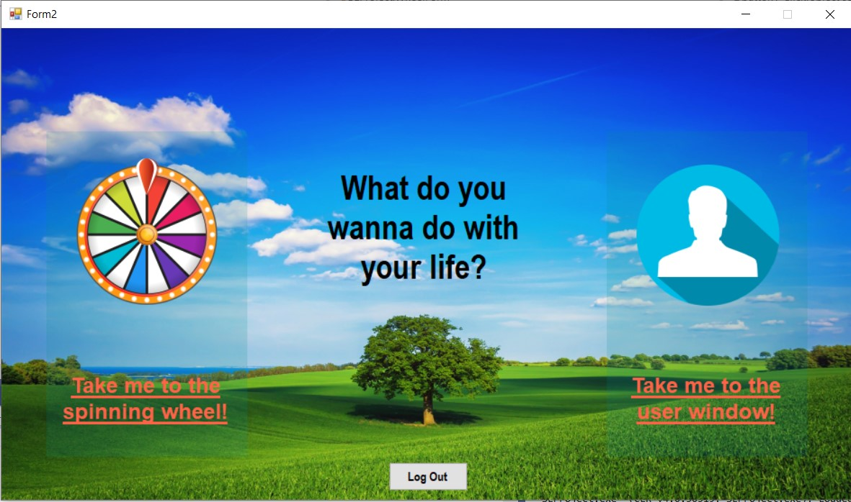
Screenshots cont’d

Slide 32
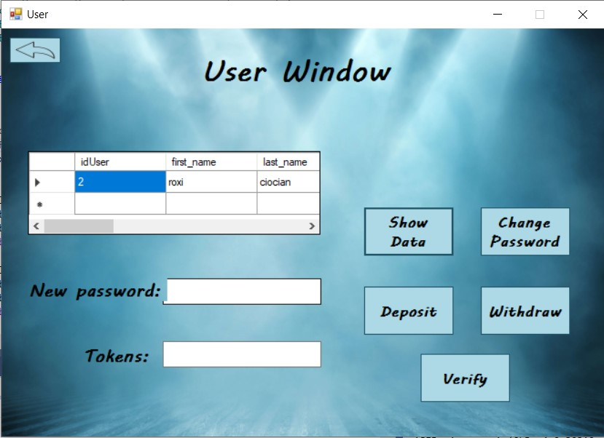
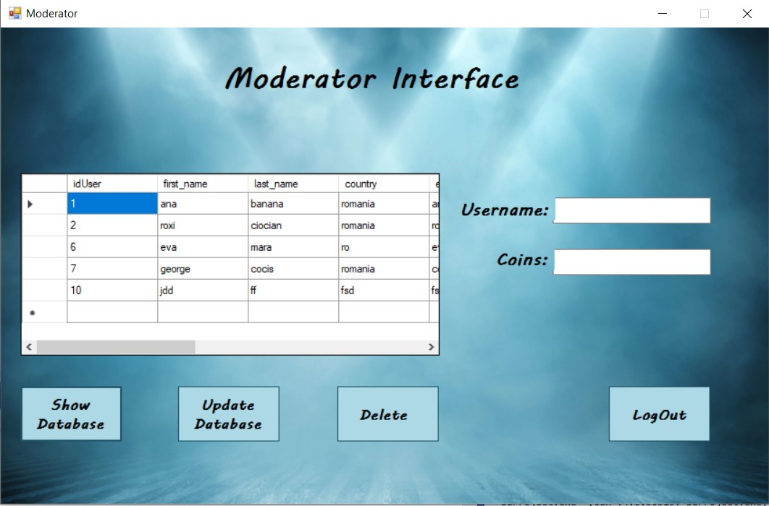
Screenshots cont’d

Slide 33
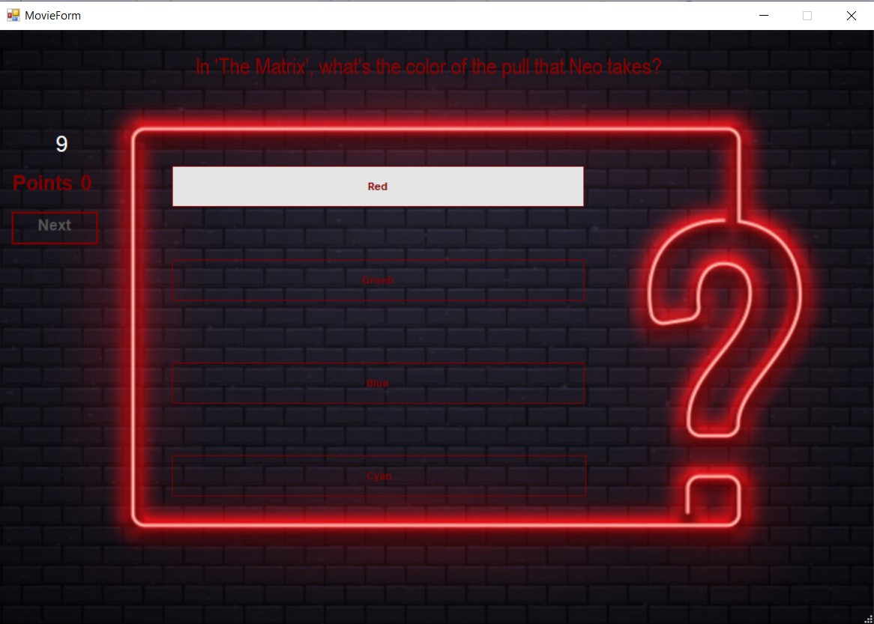
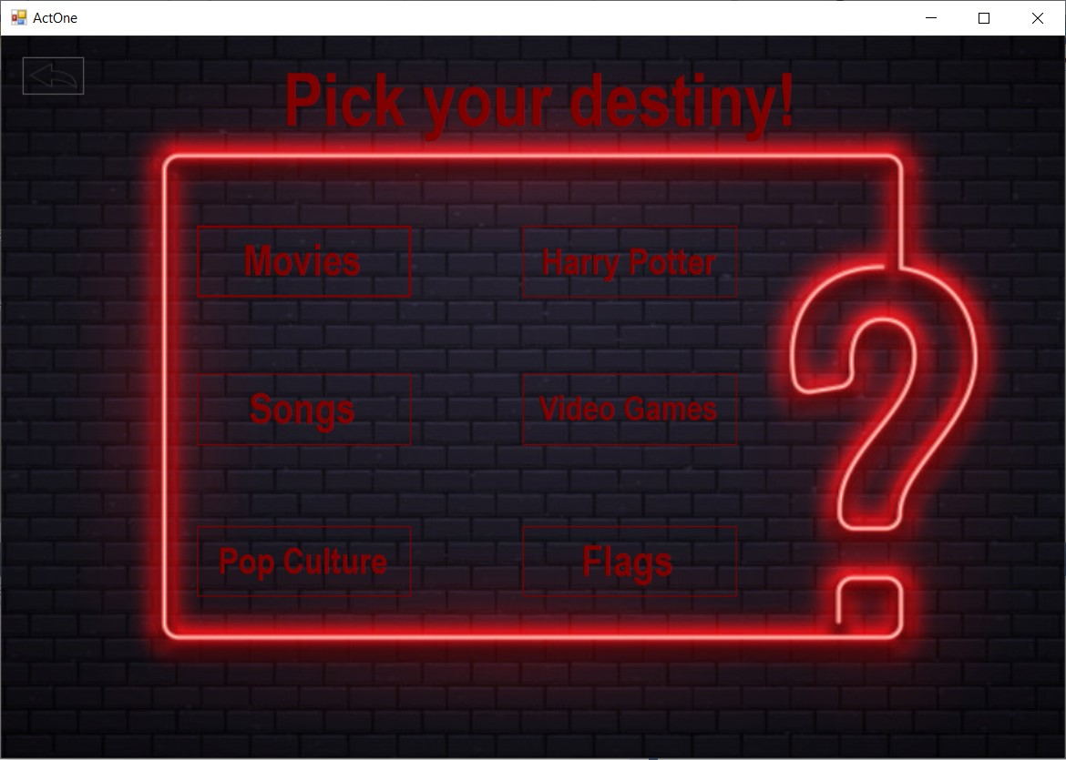
Screenshots cont’d

Slide 34
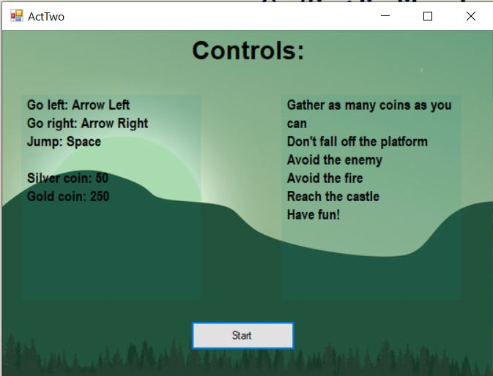
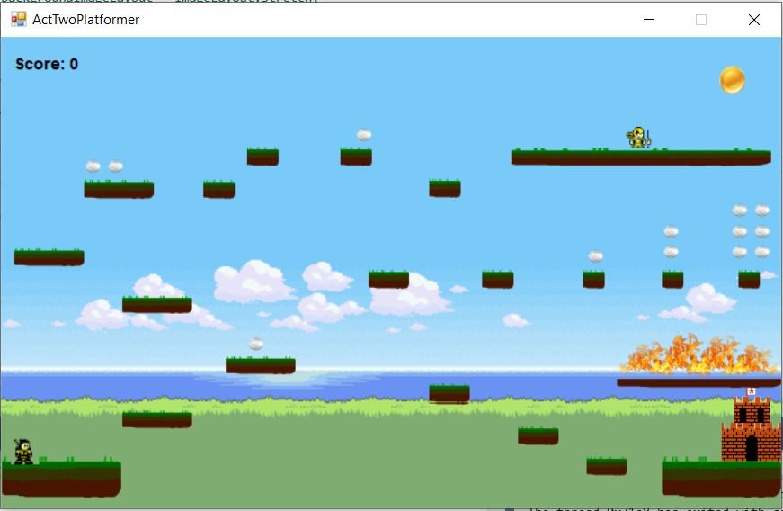
Screenshots cont’d

Slide 35
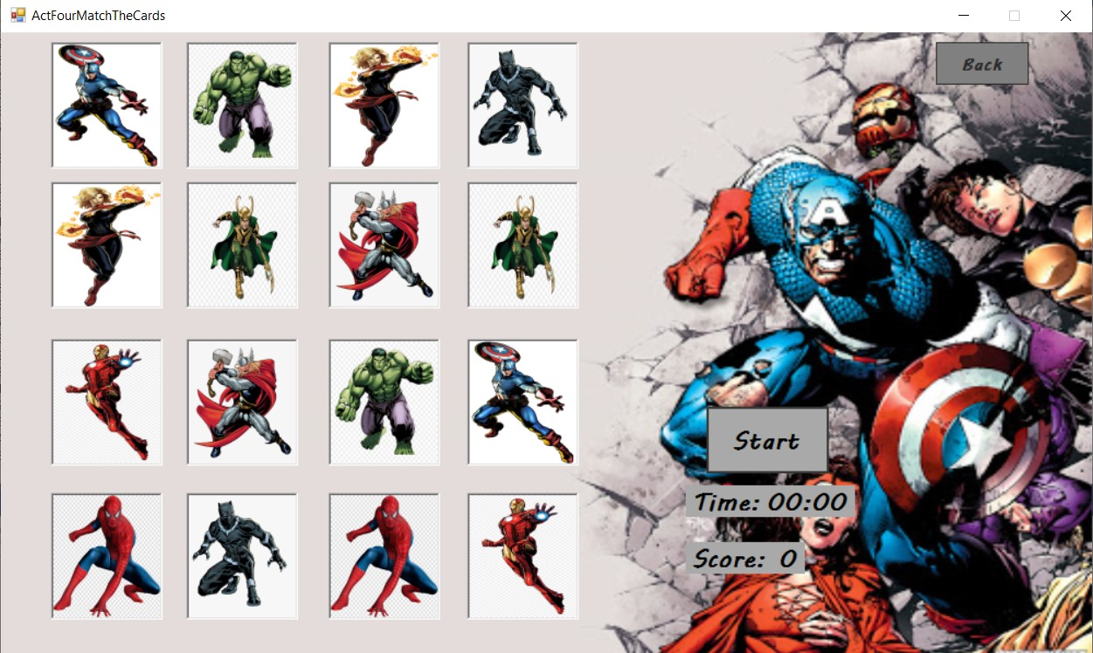
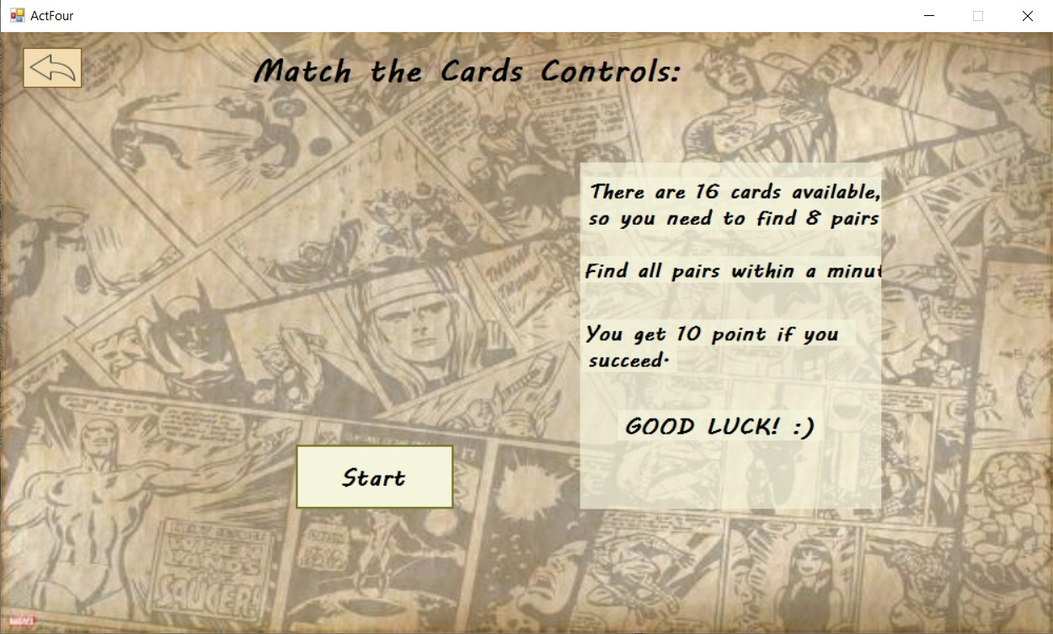
Screenshots cont’d

Slide 36
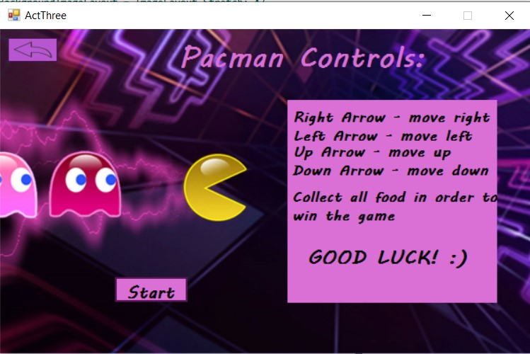
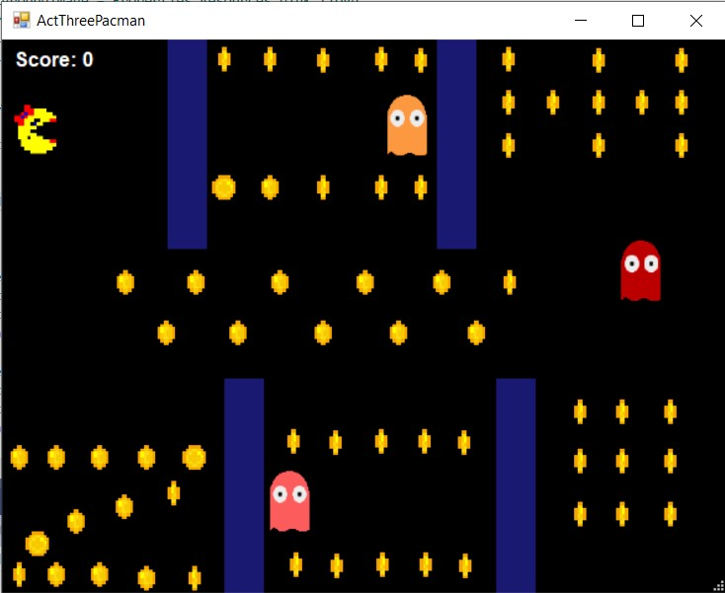
Screenshots cont’d

Slide 37
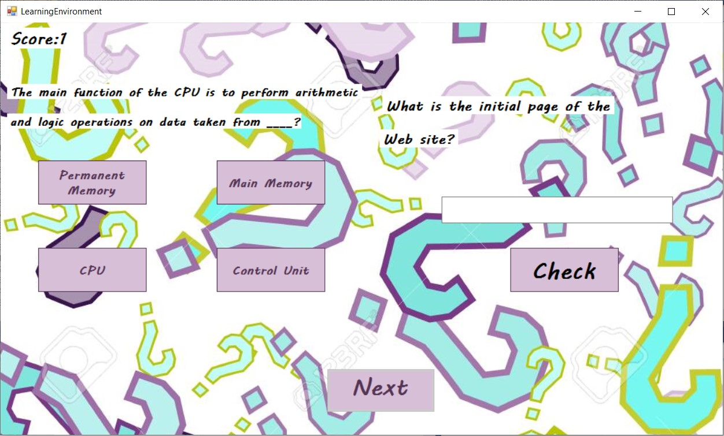
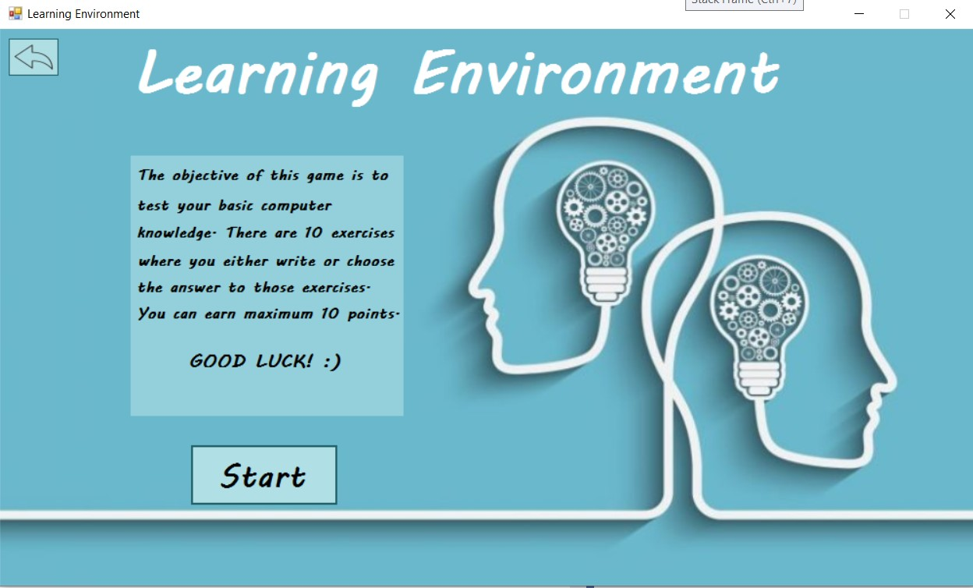
Screenshots cont’d

Slide 38
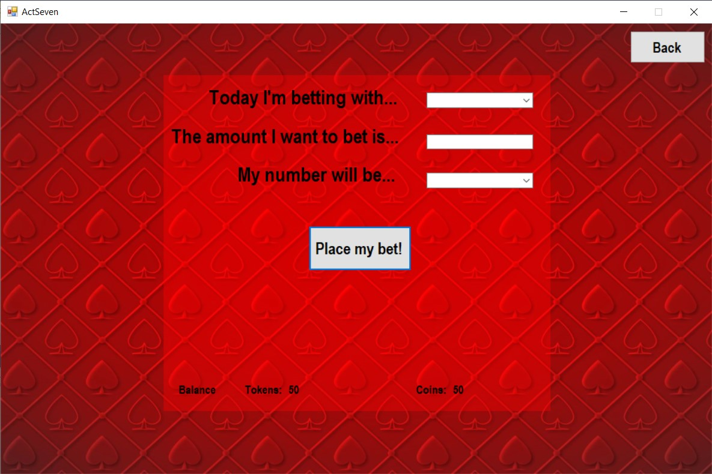
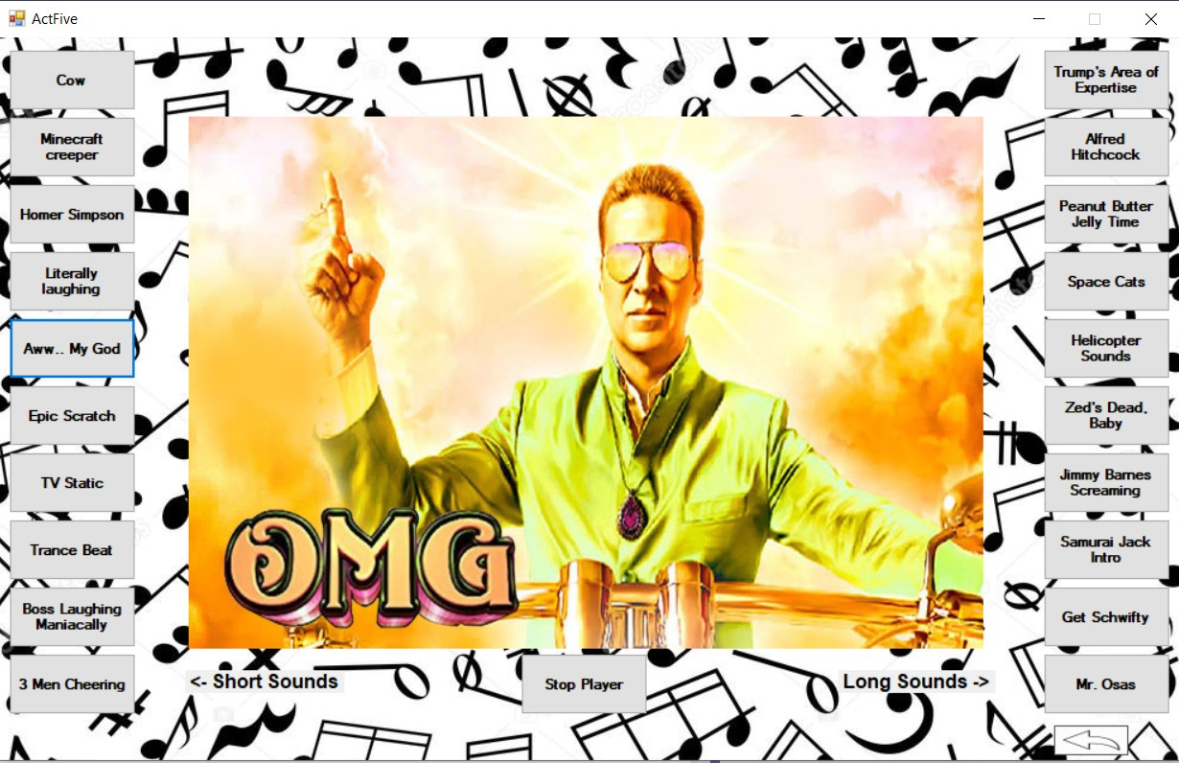
Screenshots cont’d

Slide 39
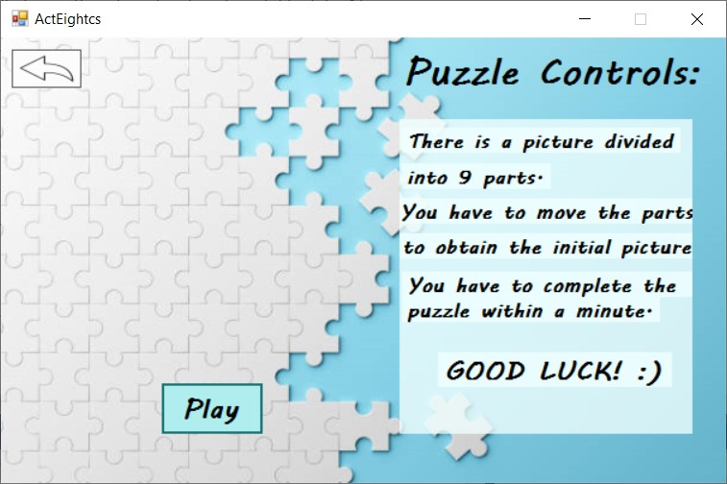
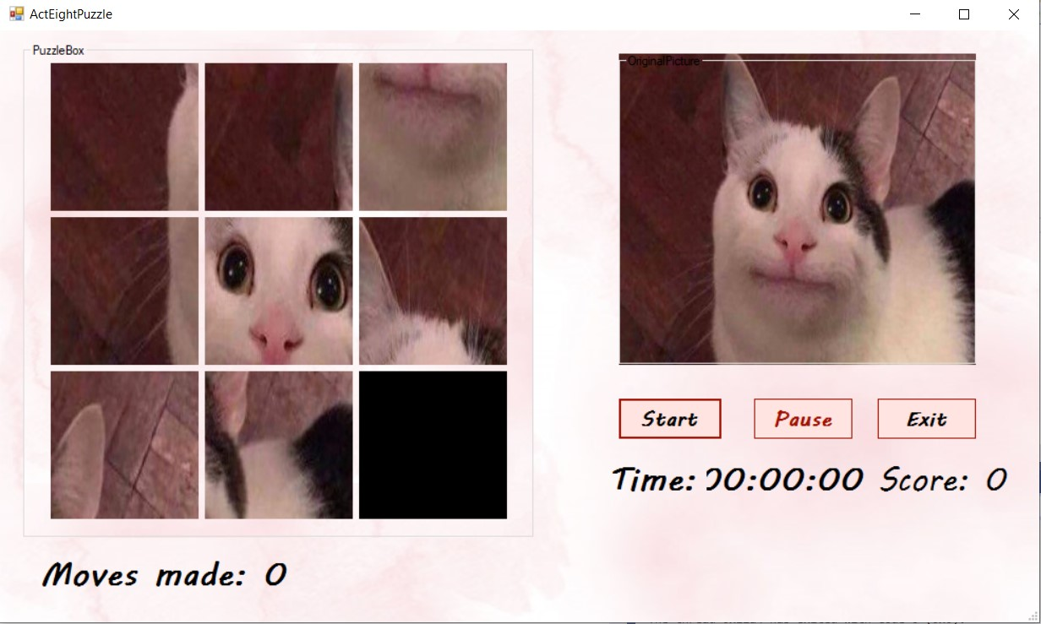
Screenshots cont’d

Slide 40
Portability
The application runs on Microsoft Windows operating system devices
The user needs the .exe file

Slide 41

Competing Software
Idea of application – spinning wheel with 8 minigames
Each minigame competes with a specific large-scale existing game i.e: Platformer <-> Super Mario, Oddworld, Trivia <-> Songpop etc.
The idea of randomly generated minigames <-> Bored Button, etc
As a whole, the application incorporates minigames uniquely

Slide 42
Testing and Validation
Errors such as:
Timer synchronization – ms, stop, dispose
Database errors – connection, queries
Application Exit Errors – exceptions, collection and event
Small bugs – easily solvable

Slide 43
Future Development
Web extension
Coins & Tokens conversion
Multiple levels for different games
Database with more questions(random) for trivia & learning
More gambling possibilities, more jukebox sounds
Possibility of selecting puzzle picture
Interactive wheel & a better design overall

Slide 44
The end
Project by Roxana Ciocian & Cocis George

